Slide 1
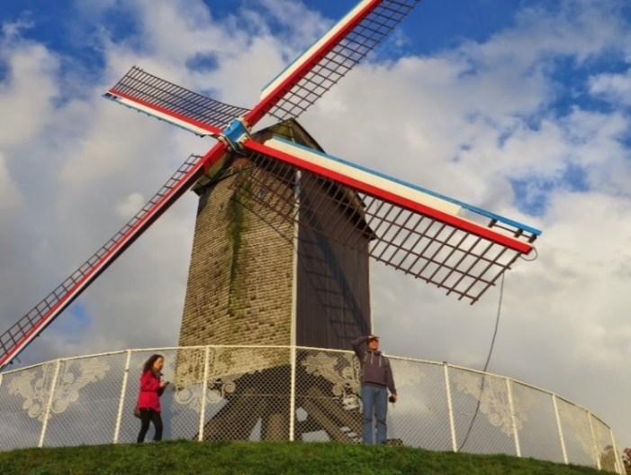
STUDYING ABROAD
2018/2019
Foreign Relations Department
BUT Rectorate
13 March 2018

Slide 2
1987
2014–2020
1994–2006
2007–2013
2018
2017

Slide 3
WHY PARTICIPATE IN ERASMUS+?
Erasmus+ improves employability of students
Erasmus+ improves language skills
23% lower unemployment rate 5 years after graduation
64% of employers give more trust to employees with an international experience
40% of participants live in a foreign country after graduation

Slide 4
Overview of BUT students studying abroad in 2011–2018
... and overview by faculties in 2016/2017

Slide 5
Overview of students studying abroad in 2017/2018 by countries

Slide 6
STUDYING ABROAD (SMS)
WHAT: study in courses* or work on your Bachelor’s/diploma thesis during your stay at a university abroad
WHEN: in period between June 1 2018 and September 30 2019
FOR HOW LONG: at least 90 days, not longer than 360 days
WHERE: see the next slide
COSTS: see slide 29

Slide 7
Participating countries
28 states of the EU
3 countries within the EFTA
2 candidate countries

Slide 8
BREXIT?
Nothing has changed so far
British universities and companies are eligible to receive and send out students and employees
In the future, it will depend on the negotiations between the United Kingdom and the EU regarding, among others, the area of education
British universities as well as the British National Agency are putting an effort to keep the status of a participating country
You will be notified of any further information

Slide 9
ADMINISTRATION OF THE STAY
1. Do not be afraid!
2. Study available information.
3. Meet all deadlines
4. Ask questions*

Slide 10
CONDITIONS FOR PARTICIPATION (General)
nomination to participate based on a selection procedure ✓
being duly enrolled and active student of an accredited study programme (both full-time and combined forms of studies, no limitation by the year of study)
students can study abroad in period from 1 June 2018 to 30 September 2019
previous participation: the overall sum of all study and working stays within the Erasmus+ programme as well as the preceding LLP/Erasmus programmes must not exceed 12 months, or 360 days in a given study cycle

Slide 11
ADMINISTRATION PROCEDURE (Checklist)
Before you leave
Application
Acceptance letter
Learning Agreement
Arrange your accommodation
Participation Agreement
OLS #1
DEPARTURE!
During your stay
Changes to LA
Application for extension (?)
Application for reduction (?)
After you return
Confirmation
Transcript
EU Survey
OLS #2
Application for recognition of results
Report in the DZS database (optional)

Slide 12
BEFORE LEAVING (1)
nomination to participate based on a selection procedure ✓
After the selection procedure, the student needs to know 3 things for sure:
1. WHERE is he/she nominated to go (country)
2. FOR HOW LONG is he/she nominated to go (in months)
3. FOR WHICH PERIOD is he/she nominated to go
(winter semester, summer semester, academic year)
Administration of the formal tasks
in co-operation with student’s faculty (mainly the academic matters)
in co-operation with the FRD (matters regarding agreements and financial support)
individually (accommodation, insurance, visas, ISP etc.)

Slide 13
BEFORE LEAVING (2)
submitting application to the host university
the student needs to find out the submission deadline
fill in the form provided by BUT or foreign university, possibly online
student receives acceptance letter
it might be necessary to explicitly ask the host university to provide the letter
Acceptance letter
can have various forms
It must include:
the student’s name
confirmation of acceptance by responsible employee of the foreign university
period of stay according to the university’s teaching schedule – beginning/end date (for the definitions of the first and the last day of the stay -> see Qualification conditions)
it might be necessary to obtain a schedule of accompanying activities (language courses, orientation week ...)

Slide 14
BEFORE LEAVING (3)
drawing up the Learning Agreement (LA)
the student fills in:
clear identification of the parties (student, BUT, host university)
specific period of his/her stay (for definitions of the first/last day see the Qualification conditions)
list of courses related to his/her field of study which he/she wants to take at the host university, based on course catalogue provided by the host university
courses amounting to at least 18 credits, or 11 credits if the student will also work on his/her thesis, per semester
(see the Guidance No. 18/2017)
The student and the faculty agree on:
approval of the proposed study plan, including work on diploma thesis, if relevant
Diploma thesis written in a foreign language, consulted and supervised by a foreign supervisor
approval of proposed courses (table B)
execution by the guarantor of the study stay from the faculty (academic worker, usually the
head of department, vice-dean for Study Affairs or vice-dean for international relations etc.)
LA can be signed electronically (the signature must be legible)

Slide 15
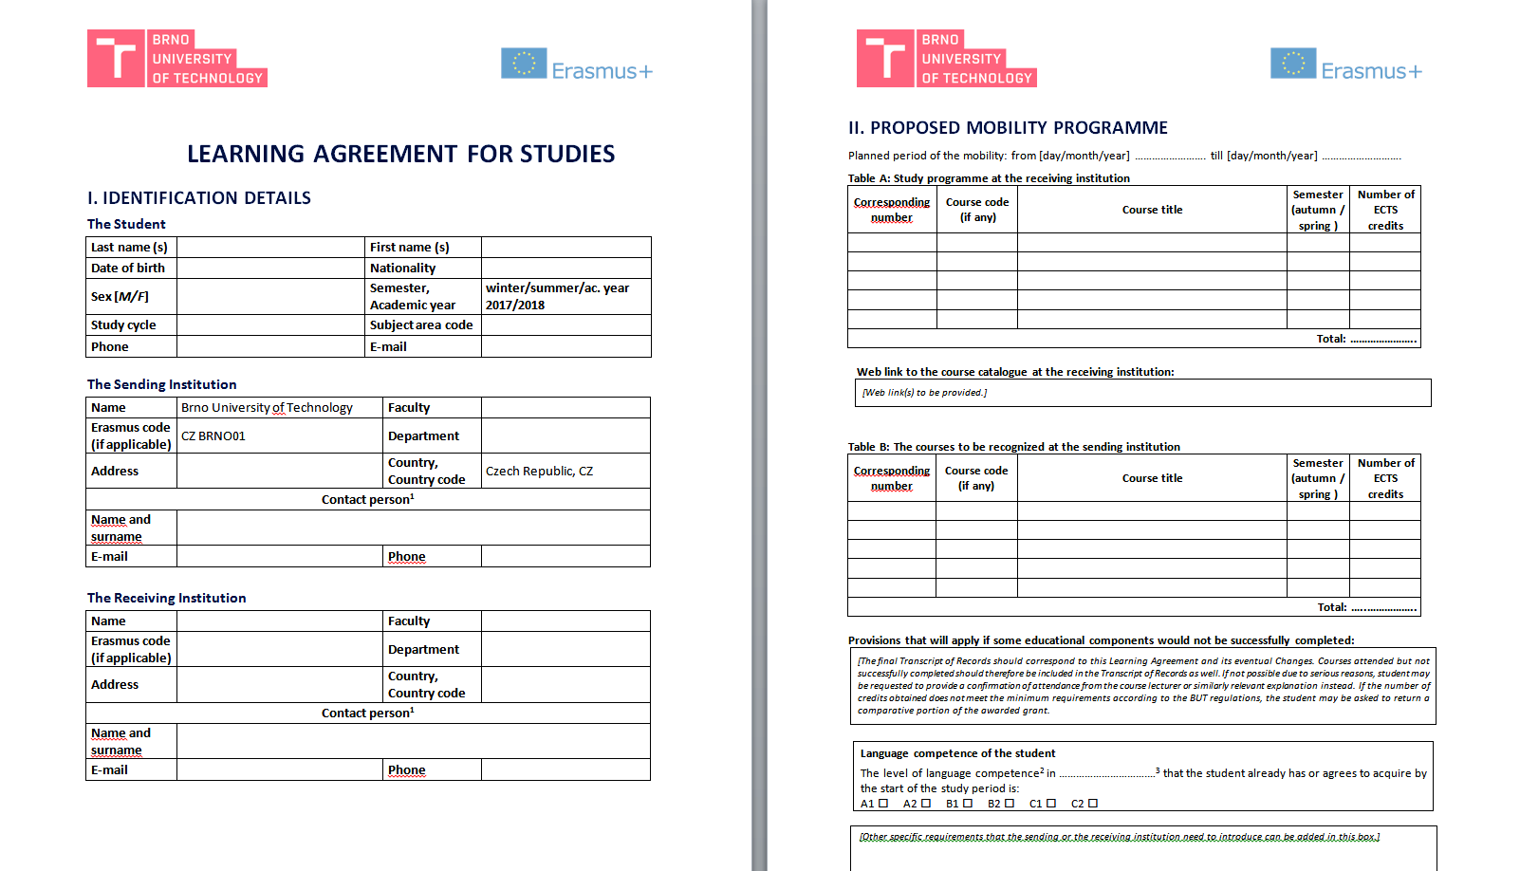
LEARNING AGREEMENT (1)

Slide 16
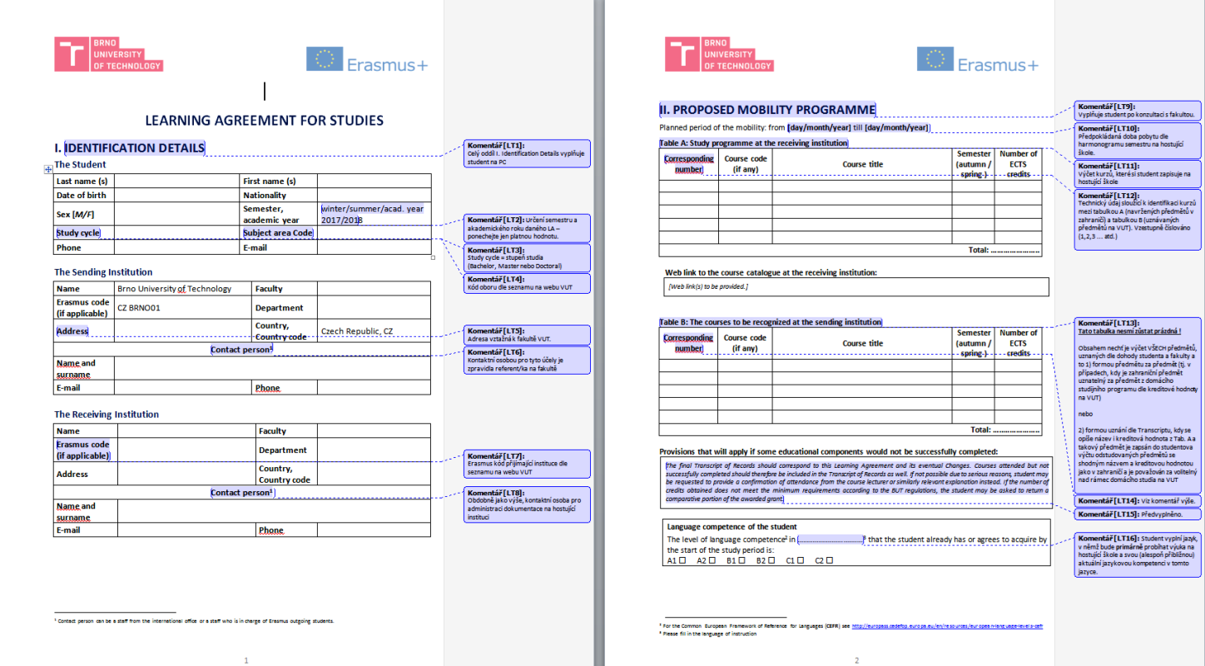
LEARNING AGREEMENT (2)

Slide 17
BEFORE LEAVING (4)
other possible things to administer at the faculty
Individual Study Plan (if necessary)
enrolment in the next year (particularly for study stays during summer)
execution of the Participation Agreement
in person at the FRD of the Rectorate
(it can be executed through a power of attorney only in exceptional and justified cases)
recommended time – 2 to 3 weeks before the planned departure
the text of the agreement as well as qualification conditions are available on the website
(for reading only, documents will be printed on site at the FRD)
what should you take with you?
one copy of the Learning Agreement approved by both parties
one copy of the acceptance letter
filing an online language test in the OLS

Slide 18
BEFORE LEAVING (5) - OLS
Test before/after the mobility is mandatory for all participants except for native speakers (or equivalent)
new rule: student submitting certificate of language knowledge on the level C1 or higher will be considered equivalent to a native speaker
a link for logging in will be sent to the contact e-mail after execution of the Participation Agreement or at the latest when the mobility starts
depending on the resulting language level it is possible to assign to the student a licence for an online language course (free of charge) to use during the mobility
the course will be assigned automatically for B1 level or lower
the use of the course is voluntary but it is advisable to use it, it measures the time spent in the course
What can be done if...?
you cannot find the link for the OLS test for any reason
a) are you checking your school e-mail?
b) have you checked the spam folder?
If neither (a) or (b) help, you need to contact the FRD to deal with the situation
failure to complete the OLS constitutes a breach of the agreement and it may result in the obligation to return the whole the scholarship or its part

Slide 19
DEPARTURE!

Slide 20
DURING YOUR STAY
written administration of changes to LA
not later than 30 days after the beginning of the stay
in justified cases can be later, immediately after such changes occur
the Changes to Learning Agreement form (again signed by all parties)
inform the FRD of the Rectorate if there are no changes
notification of a possible reduction of the stay
see below
possible application for extension of the stay
see below

Slide 21
AFTER RETURNING (1)
submission of the Confirmation of Erasmus Study Period
document issued by the host university at the very end of the stay
there is a sample document on the FRD website
it serves as evidence of the actual length of the stay
student hands in the original to the FRD of the Rectorate and a copy (if required) to his/her faculty
deadline for submission: within 15 days after the end of the stay
submission of the Transcript of Records
document will be sent to the student/BUT by the host university
it serves as evidence of all completed and attended courses
student will submit a copy to the FRD of the Rectorate
submission deadline: within 45 days after the end of the stay or before 15 October 2019 (whichever occurs earlier)

Slide 22
AFTER RETURNING (2)
filling the final report (EU survey)
online in the application of European Commission
link to the report will be sent to student’s e-mail after the end of the traineeship
deadline for submission: within 15 days after the receipt of the notification to fill in the report
filling final online language test in the OLS
similar to the test taken before the mobility, comparative test
a link for accessing the test will be sent to the student during the last month of his/her stay
arrangements for the recognition of attended courses by the faculty
as agreed in LA
the faculty will provide the Proof of Recognition to the FRD of the Rectorate

Slide 23
EXTENSION OF STAYS
Application for Extension
3-in-1 form including application, motivation letter and LA
filled application confirmed by both parties is to be submitted to the FRD of the Rectorate
not later than 30 days before the original end of the stay
date of submission = day of delivery of the application to the Rectorate according to conditions described above
only on grounds of study reasons
the length of the extended stay must not exceed the total of 12 months of all student’s Erasmus stays or exceed the date of 30 September 2019 – whichever occurs earlier
the application does NOT automatically create entitlement for additional financial grant

Slide 24
REDUCTION/CANCELLATION OF STAY
reduction of the stay
a stay to study abroad can be reduced down to the minimum length of 90 days
student must meet the requirements stipulated in the Participation Agreement, i.e. the content of LA and he/she must gain at least 18 ECTS credits/semester
the Participation Agreement can be changed by amendment
Cancellation of stay
undesirable, the nomination is binding
only on grounds of serious reasons
the student must notify the FRD of the Rectorate and his/her faculty without undue delay and fill in the forms online

Slide 25
KEEP IN MIND
deadlines
set by the FRD of the Rectorate (in the Participation Agreement)
set by the host university (applications, LA, request for accommodation in dormitories)
set by the faculty (deadline for enrolment, recognition of results etc.)
OLS!
insurance, visas (if needed)
The student is required to arrange medical insurance for the host country, and, in case of traineeship, also third-party liability insurance and accident insurance
The student may be required to acquire visa or to arrange for a specific insurance (Turkey)
fulfilment of the study plan and acquiring the minimum amount of credits required
failure to fulfil the study plan may result in the obligation to return the whole scholarship or its part
exceptions are possible only in cases of force majeure approved by the National Agency

Slide 26
PROGRAMME FUNDING (1)
Based on the nomination, student is eligible to receive financial support for mobility for the period of his/her stay in flat-rate amount set according to the host country and the length of the stay in days as calculated by the tool for calculation of the number of days
funding sources: EU grant, contribution from the State budget for the support of internationalisation or both
host countries are divided into three groups based on relative costs
the financial support is only a contribution, the student is expected to participate in paying for the expenses
the payment of the financial support is done in 1–2 instalments by a wire transfer to:
a) bank account in CZK kept by any bank in the Czech Republic
b) bank account in EUR kept by Komerční banka, a.s.

Slide 27
PROGRAMME FUNDING (2)
CHANGES IN GRANTS FOR 2018/2019
For the 2018 call, there have been the following changes in the division of countries into the grant categories:

Slide 28
PROGRAM FUNDING (3)
CHANGES IN GRANTS FOR 2018/2019
in addition to the above stated changes in the division of countries into the grant categories, there are also changes in the flat-rate amounts for the support for individual categories on the national level:
lower costs: 330 EUR/30 days (formerly 300 EUR)
medium costs: 450 EUR/30 days (formerly 400 EUR)
higher costs: 510 EUR/30 days (formerly 500 EUR)
this means that the grants have been increased for most countries
BUT will be reflecting the changes and in particular the reduced grants for FR, IT and AT

Slide 29
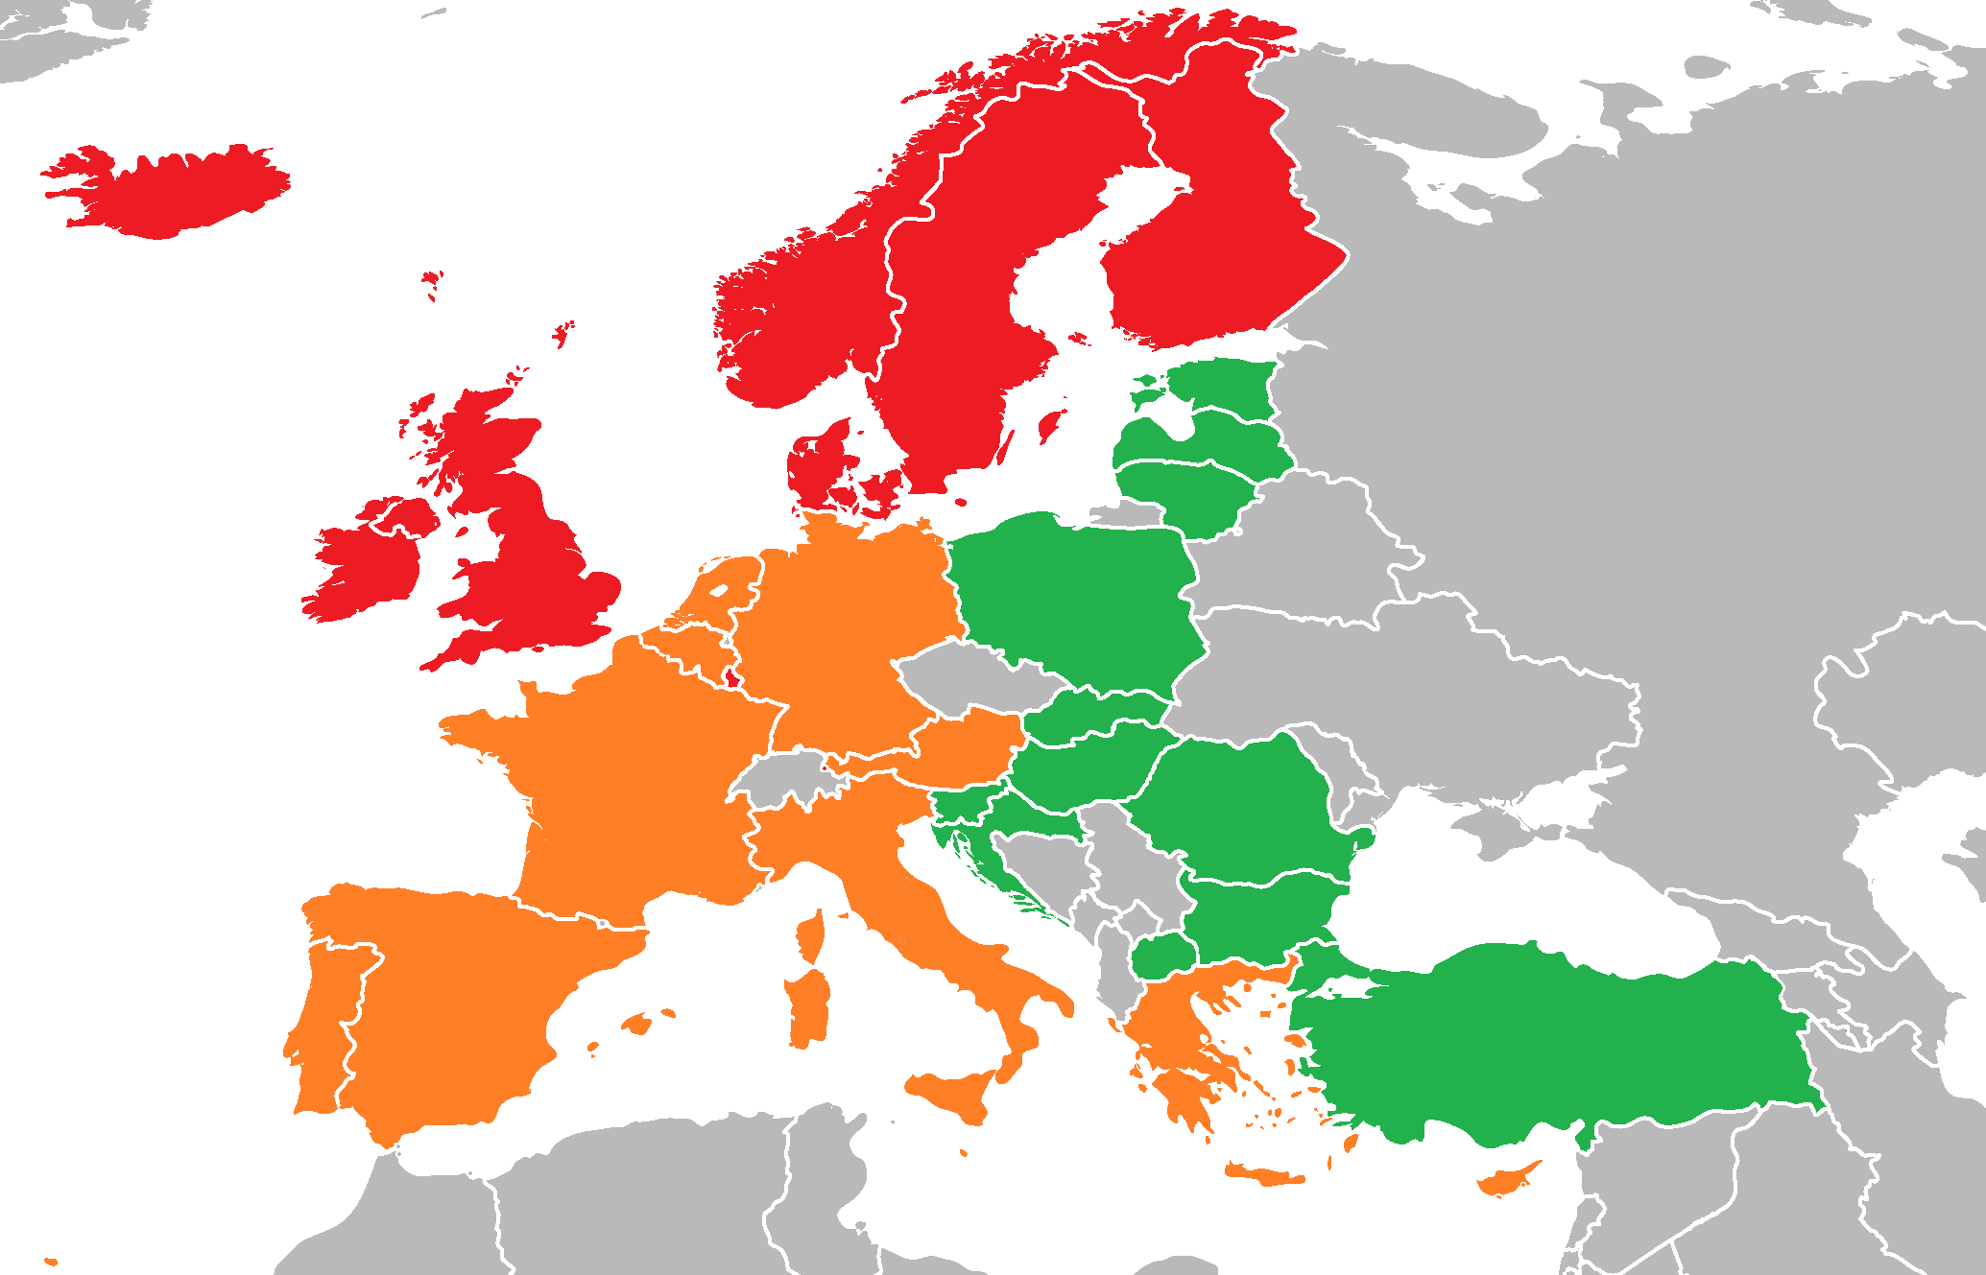
PROGRAMME FUNDING (4)
SMS EUR/ 30 days
510
450
330

Slide 30
PROGRAMME FUNDING (5)
it is still possible to combine the basic financial support with:
additional contributions by the faculty/FRD of the Rectorate (P17/2017)
financial support for students with special needs
(application to be sent to the DZS via the Rectorate, calculation according to actual costs)
financial support for students coming from socio-economically disadvantaged background
(application on the FRD website, the criteria are: entitlement to family allowance and the decisive family income for the relevant period lower than 1.5 times the living minimum)
salary or other consideration from the host company in case of combined mobility, or from local authorities
it cannot by combined with funding from other EU programmes

Slide 31
ADMINISTRATION (1): Competence
Faculty
selection procedure
approving of LA and possible changes to LA
Recognition of results (Rector’s Directive No. 1/2016)
FRD of the BUT Rectorate
contractual and financial administration of the whole project
Participation Agreements, finance allocation
interim and final accounting
Both university bodies
keeping documentation regarding participants’ agenda
cooperation in dealing with possible issues that are decisive for the financial agenda
programme promotion, provision of information

Slide 32
ADMINISTRATION (2): Originals/copies of documents
the FRD of the Rectorate keeps the originals of the following documents:
Participation Agreements
possible amendments to Participation Agreements (extensions, refunds)
Confirmation of Erasmus+ Study Period
= a copy of the LA is sufficient for the purpose of drawing up the Participation Agreement
= submitting of copies of potential application for extension is also sufficient
if the documents are to be signed electronically
Bring one set of copies of all documents for your faculty (if required) and one set for yourself.

Slide 33
ADMINISTRATION (3): Contact hours
See the BUT website for contact hours of the FRD and of individual faculties
FRD contact hours:
Monday, Tuesday, Thursday 8:30 a.m.–12:00 p.m.
Wednesday 9:00 a.m.–11:00 a.m. and 1:00 p.m.–3:00 p.m.
it is possible to schedule a meeting at other times, if necessary
(contact us by telephone or e-mail)
the above contact hours are valid all year round
in case of absence, a substitute contact person will be identified

Slide 34
ADMINISTRATION (4): Your contact information
your telephone number should be stated in the LA
e-mail:
always use your university e-mail address (*.vutbr.cz)
During your Erasmus stay, you need to:
keep enough free space in your inbox
check your university e-mail inbox regularly
check the spam folder from time to time
(automatically generated messages from the OLS or EU Survey)

Slide 35
ADMINISTRATION (5): Resources you should read through
website of the FRD of the Rectorate https://www.vutbr.cz/studenti/staze/pobyty/erasmus
text of the Participation Agreement
Annex No. 1 to the Rector’s Guidance No. 18/2017
related internal standards
Frequently asked questions
https://www.vutbr.cz/studenti/staze/faq

Slide 36
CONTACT PERSONS
FOREIGN RELATIONS DEPARTMENT
Bc. Tomáš Lády, Erasmus+ Institutional Co-ordinator (student A–J)
Rektorát VUT v Brně,
Antonínská 548/1 - office 1.33a (ground floor, right hand side)
Tel.: +420 541 145 145
E-mail: lady@ro.vutbr.cz
Bc. et Bc. David Gurník, Erasmus+ responsible officer (students K–Ž)
Rektorát VUT v Brně,
Antonínská 548/1 - office 1.35 (ground floor, right hand side)
Tel.: +420 541 145 116
E-mail address: gurnik@ro.vutbr.cz
FACULTY CO-ORDINATORS
https://www.vutbr.cz/studenti/staze/kontakt

Slide 37
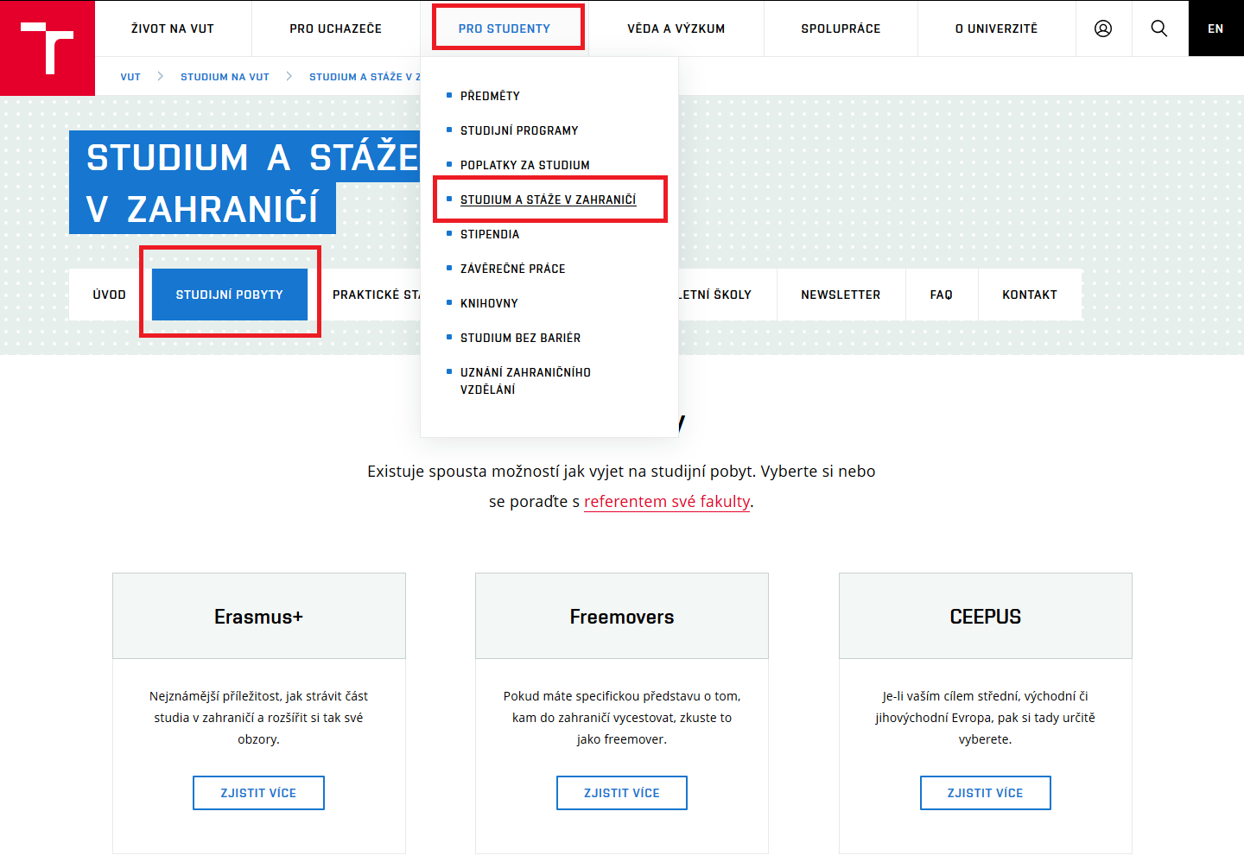
FRD WEBSITE – studying abroad
Updated in spring 2018
You can find there:
Documents for downloading
Complete application procedure
Frequently asked questions
https://www.vutbr.cz/studenti/staze/pobyty

Slide 38
FURTHER INFORMATION
FRD Newsletter (in the menu of the FRD website)
FRD Facebook: Go International with BUT
https://www.facebook.com/BUTinternational
DZS’s website on the Erasmus+ programme
http://www.naerasmusplus.cz/
Database of students’ final reports
http://erasmus-databaze.naep.cz/modules/erasmus/

Slide 39
Database of reports
student/trainee reports
students from all of the Czech Republic
easy search
practical information
online – public access
participants share their experience voluntarily
http://erasmus-databaze.naep.cz/modules/erasmus/

Slide 40
THANK YOU FOR LISTENING!

