Slide 1
Startup Newbies and Lean Startup: A Case Study
Ing. Jakub Ulč
BUT, Faculty of Business and Management
Workshop specifického výzkumu 2022

Slide 2
Purpose and Motivation
Empirical Framework of the Marketing Strategy of Technology Start-ups: The Lean Start-up Method
Empirical Framework of the Marketing Strategy of Technology Start-ups: The Lean Start-up Method
Junior Specific Research Project 2021
Junior Specific Research Project 2022
Notes:
I am the proposer of project

Slide 3
Introduction
Startup founders are motivated by the idea of be rich, improving the world's standard of living, creating a unique and groundbreaking idea/technology solution, and more.
High level of startup ecosystem – CzechInvest, JIC, MPO,…
Two unicorns in CZE (Productboard, 2022; Rohlik Group, 2022)
First two stages, the lean startup approach (LSA) is highly visible in a large number of startups (Ulč, Mandel, 2021)
Story of Startup Newbies - DSparx Tech – Training Lights
Notes:
I dare suggest that everyone has someone in their business or academic environment who considers themselves a startup founder and is driven by their drive to work on their project.

Slide 4
Purpose of Paper and Scientific aim
Illustrate the context / principles of lean startup approach for a startup in practice
The aim of this paper is to identify to how far the startup DSparx Tech uses a lean startup approach and what steps in the past correlate with LSA

Slide 5
Research questions
RQ1: Which activities of the DSparx Tech startup in the market are in the way of the lean startup approach?
RQ2: How far can we describe the DSparx Tech startup as lean?

Slide 6
Theorethical backgound
First mention of LSA - Eric Ries in 2008 on his blog = "a combination of agile and customer development and building on existing systems to eliminate redundant effort" (Ries, 2008)
The essence of LSA is the adoption of an iterative approach driven by experimentation instead of a business model based on business planning (Contigiani & Levinthal, 2019)
LSA is based on MVP, pivoting and supported by iterative build-measure-learn = BML loop (Blank, 2013; Ries, 2011; Ghezzi, 2019)

Slide 7
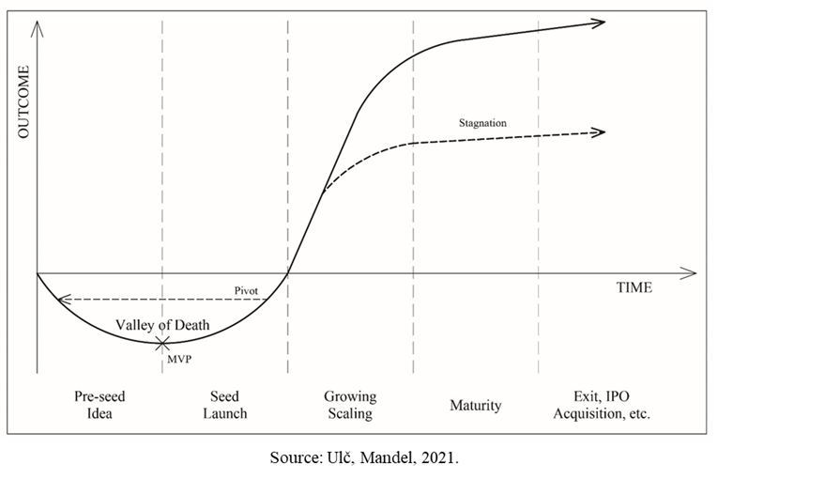
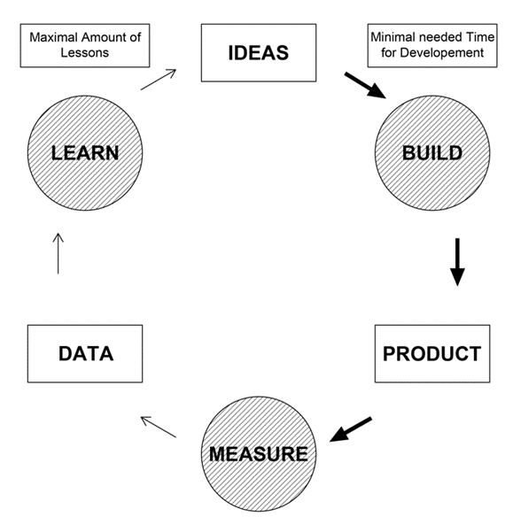
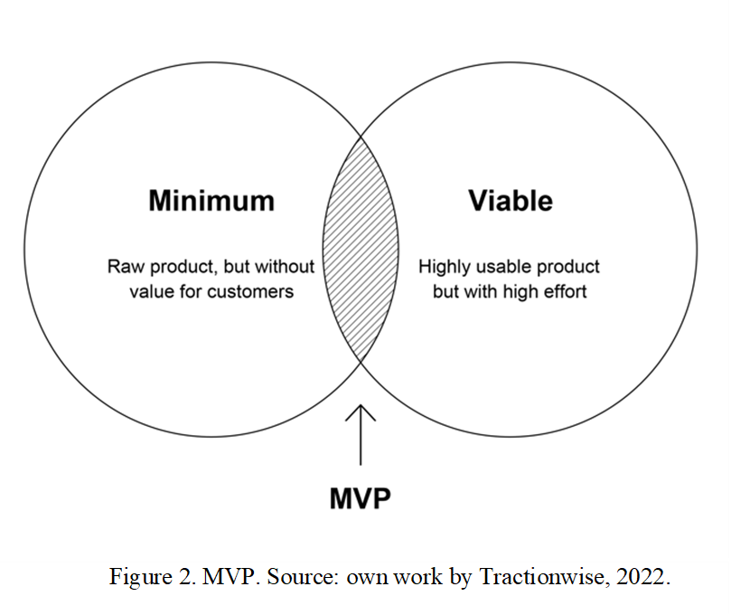

Slide 8
Methodology
Research questions are explanatory in nature = case study method (Jin, 2009)
Semi-structured interviews, analysis of the startup's secondary data in the form of financial statements, reports and business plan, observation
Interviews were conducted online, then transcribed and evaluated using codes in MAXQDA software
DSparx Tech - Pre-Seed / Idea and Seed / Launch stages, and finding the similarities with LSA

Slide 9
DSparx Tech
2020
3 founders, years of experience in professional volleyball as well as technology ideas, due to their studies at ČVUT
Innovative solution for specific volleyball training sessions
Invested around 1.5 million in equity
During its life cycle, go to market and sell several licenses (0,15 milion)

Slide 11
Pre-Seed / Idea stage by DSparx Tech
The first prototype was a bracelet in 2021
The next prototype was already a tape that could be attached to the net, the ground or somewhere else
Testing with partners, on the begin without app
No „marketing“, no business model / develop as soon as possible
4 prototypes = more than 1 milion CZK

Slide 12
Pre-Seed / Idea stage and LSA
Typical example where a startup tries to validate their business idea using BML through an MVP right from the start of their business
Startup change MVPs and „hypotheses“ based on feedback and validation of their assumptions-hypotheses
Change from a bracelet to a stand-alone tape = pivot
The focus is on the customer and creating a minimally capable product in the shortest possible time
Focus is on innovative solutions and ideas versus creating business plans

Slide 13
Seed / Launch stage by DSparx Tech
July 2022 launch of sale
Segment - professional volleyball clubs and regional youth centres
After 4 months on the market there is still not much interest but several licenses have been sold
Segment expansion - coach workshops and conferences, national teams and associations
Startup newbies opinion - less potential, where it is relatively easy to quantify how many potential customers there are in a given segment, e.g. in Europe.

Slide 14
Seed / Launch stage by DSparx Tech
Finding out that this product may not be highly scalable comes startups with a new idea = new product
This product is for a different market, but with a similar technological innovation and a higher probability of scalability
Technology Incubation project, newly created this year by the CzechInvest agency - direct financial support in the range of millions of CZK and indirect support (CzechInvest, 2022)

Slide 15
Seed / Launch stage and LSA
Because the startup has only launched the product a short time ago, it has not yet had time to get new feedback and possibly change its MVP
The new product will be with a similar technological idea, but with a different target segment and also with a bigger market = pivot

Slide 16
Discussions
DSparx Tech's is a exemplary case of LSA
In the first stage, the startup made a pivot at the very first MVP was not effective
After the product launch some hypotheses were rejected and the startup is addressing this situation - new product has a higher chance in the market and a higher scalability rate - support by CzechInvest (second pivot)
We found out what steps are in line with LSA and can also be described as lean
Startup newbies have found that they have chosen a very narrow market with lower potential

Slide 17
Conclusion
The goal was not to evaluate whether LSA is effective or not
Startup DSparx Tech uses LSA principles and we can also label this startup as lean
RQ1 and RQ2 are answered
Results are developed to demonstrate the LSA in practice and to understand the topic in a broader context
The limitations of the paper are the subjectivity in finding correlations in LSA and DSparx Tech and the interpretation of the information found from the semi-structured interview where there was personal involvement of the author of the paper.

Slide 18
Mentionable sources
Blank, S. (2013). Why the lean start-up changes everything. Harvard Business Review, 91(5).
Contigiani, A., & Levinthal, D. A. (2019). Situating the construct of lean start-up: Adjacent conversations and possible future directions. Industrial and Corporate Change, 28(3), 551–564. https://doi.org/10.1093/icc/dtz013
CzechInvest (2022). Agentura pro podporu podnikání a investic. Retrieved from: https://www.czechinvest.org/
Ghezzi, A. (2019). Digital startups and the adoption and implementation of Lean Startup Approaches: Effectuation, Bricolage and Opportunity Creation in practice. Technological Forecasting and Social Change, 146(August 2018), 945–960. https://doi.org/10.1016/j.techfore.2018.09.017
Productboard (2022). We’re making products that matter, together. Retrieved from: https://www.productboard.com/about/
Ries, E. (2008) Continuous integration step-by-step. Retrieved from: http://www.startuplessonslearned.com/2008/
Ries, E. (2011). The Lean Startup. New York: Crown Publishing Group. 320 pp.
Rohlik Group (2022). Cultivating a Better Future. Retrieved from: https://www.rohlik.group/about
Ulč, J., Mandel, M. (2021). Technology Start-up Marketing Strategy and Lifecycle: First Empirical Findings by Qualitative Research. Trends in Economics and Management, 2021, vol. 15, no. 28, p. 71-91. ISSN: 2336-6508.
Yin, R. (2009). Case Study Research: Design and Methods (4th edition).California: Sage Publications

Slide 19
Thank you so much for your interest and attention.
jakub.ulc@vut.cz
+420 605 278 095

